Slide 1
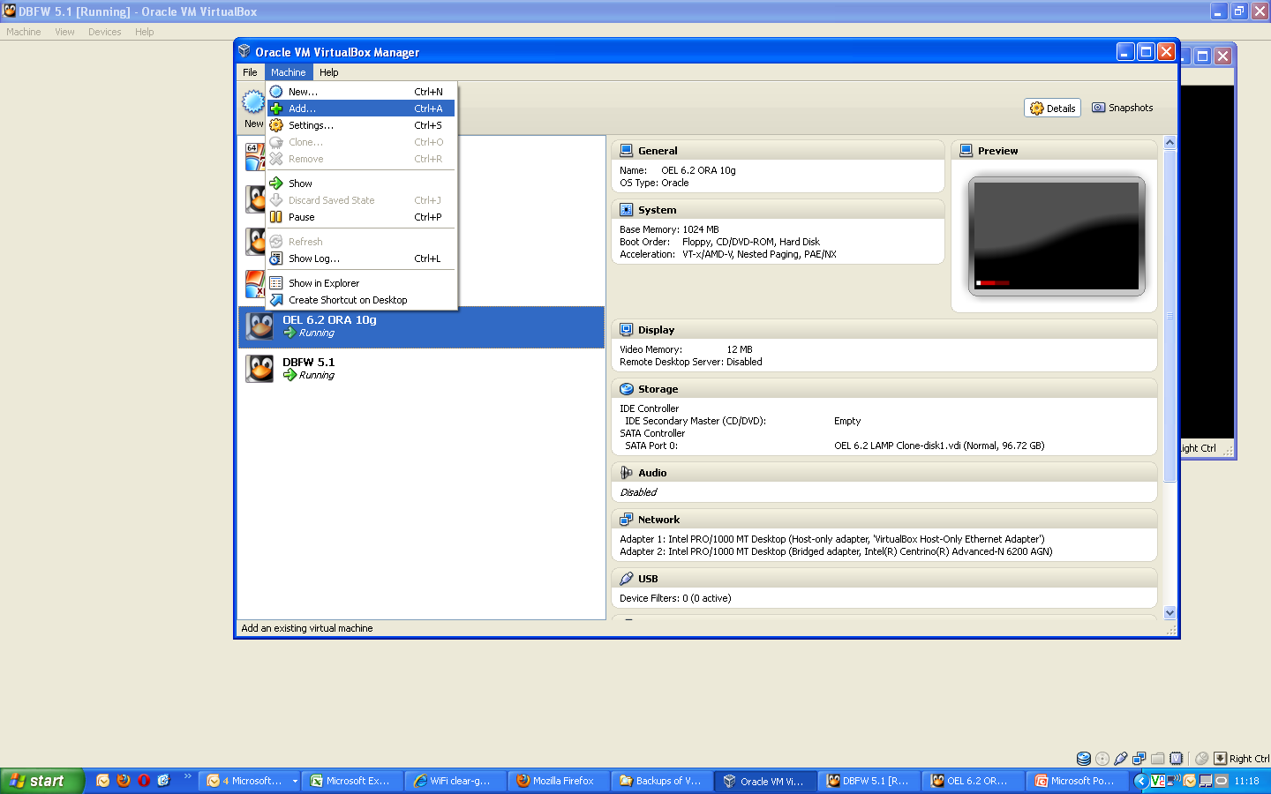

Slide 2
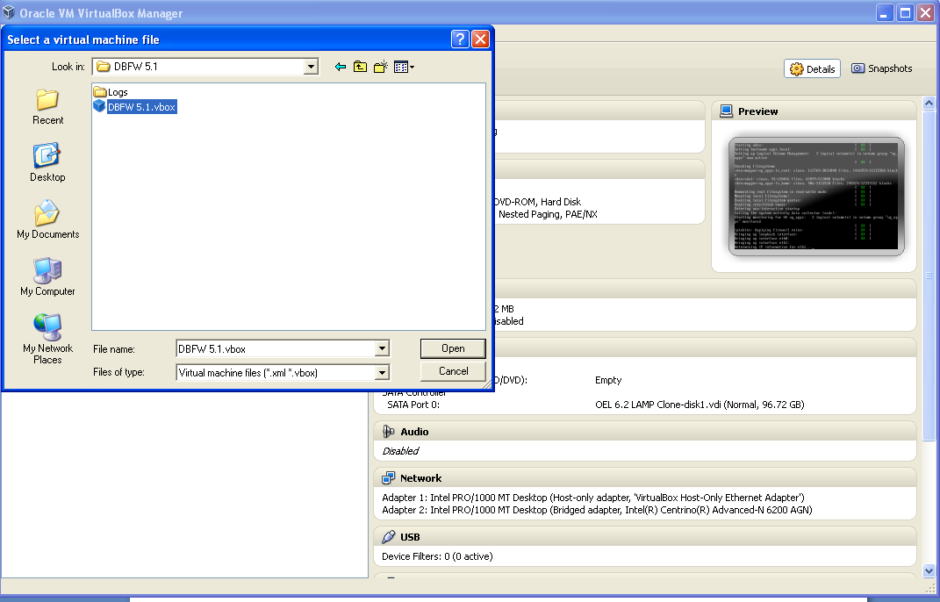
Go to the folder with the DBFW5.1.VBOX image and select this.

Slide 3
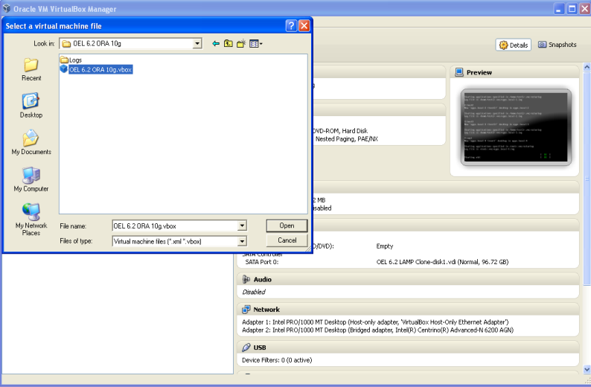
Repeat the same for OEL 6.2 ORA 10g – this is the 10g Database

Slide 4
Once images have started you should be presented with the traditional DBFW blue Screen and a logon screen for the 10g Database.
All passwords are seeingred
IP address of DBFW is 172.16.22.150
IP address of 10 Database is 172.16.22.200
Connecting over VPN will cause problems

Slide 5
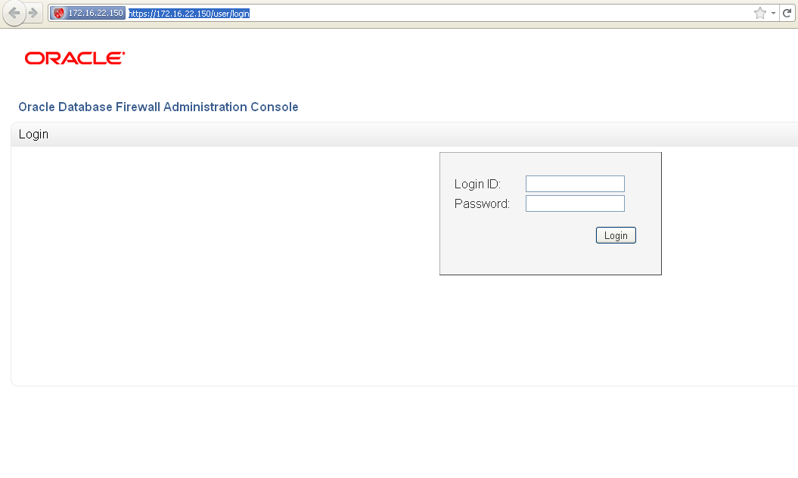
Demoing DB FW – begin with login screen
Username is admin

Slide 6
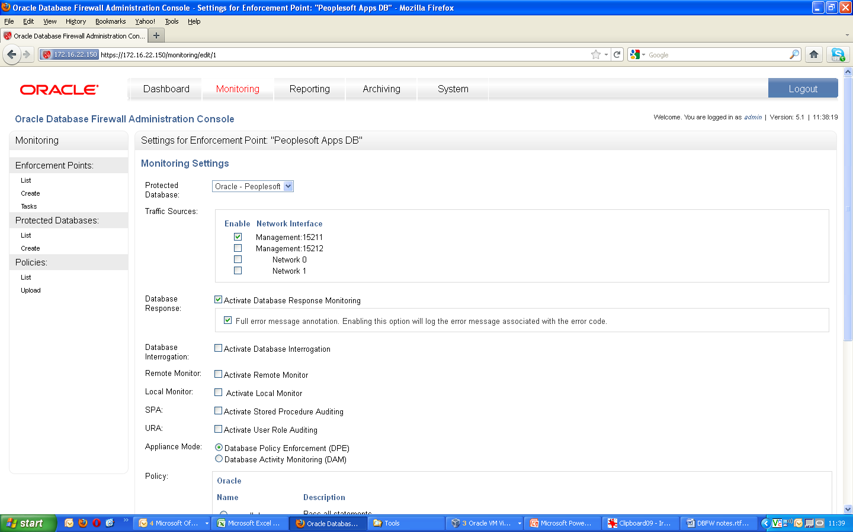
Show we are in PROXY mode monitoring>Enforcement Points>list>settings
This means that when we connect to the database we are actually
connecting to 172.16.22.150:15211 - the proxy port.
The database connection port is not published – ensuring further security for the database

Slide 7
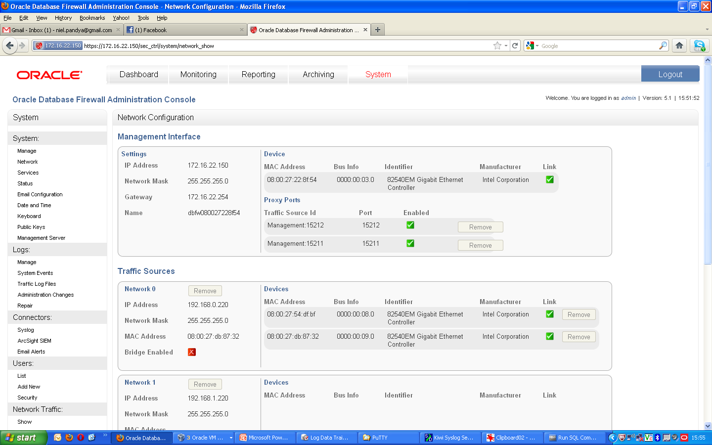
System>network shows the proxy ports setup. We can add more proxy ports – one for each database

Slide 8
Show the reports on collected traffic
Reporting>log search results>”all traffic for Peoplesoft”
Click on the last page and you can see some of the violations that are listed
We can further click on any of these and explain the forensic detail that is captured

Slide 9
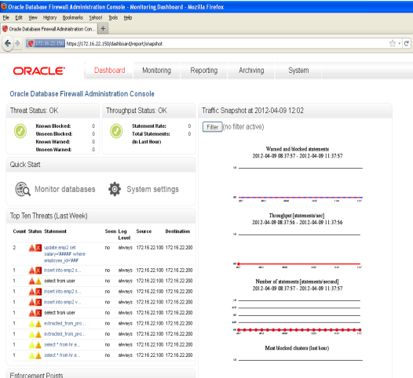
Demo the Dashboard
Click on Dashboard and show that the top 10 threats –
click on the update statement and show the masking of sensitive date in our log files
“emp2 set salary='#####' where employee_id='###'

Slide 10
Which Policy is currently enforced
On the Monitoring tab of the DBFW web portal we can go to Enforcement points> list > settings and see which policy is currently active.

Slide 11
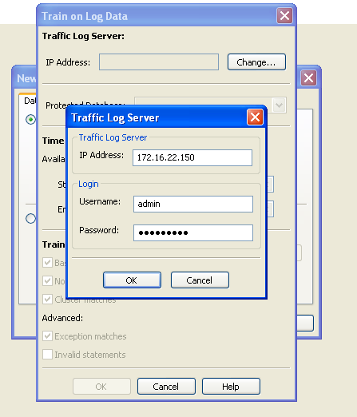
Start Oracle Database Firewall Analyzer
Click on a new model from training
Click on Change
Ensure the connection is -
And click ok -> train

Slide 12
What is DBFW Analyzer
This tool has two purposes
Creates a model based on the sample data
Creates a Policy that you can use in an Enforcement point

Slide 13
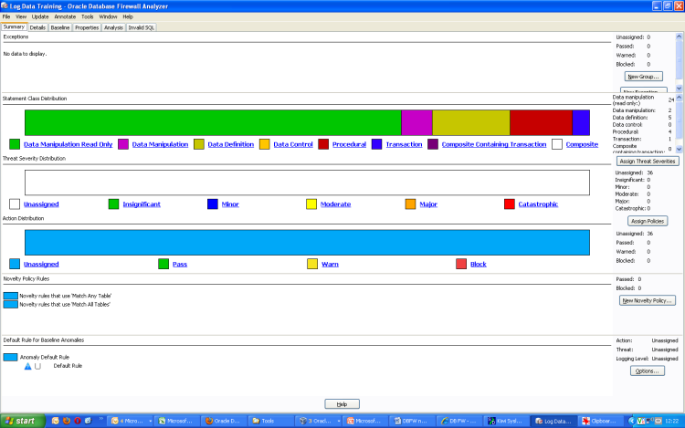
DBFW Analyzer
This first screen is very useful – it shows a break down of what our current level of risk is.
This first screen breaks down the statements into categories – these are the statements that
Were collected by DBFW
On the right hand side we can click on “ASSIGN THREAT SEVERITIES” and “ASSIGN POLICIES”
to apply the default policy and settings – when we click this we can see the display change

Slide 14
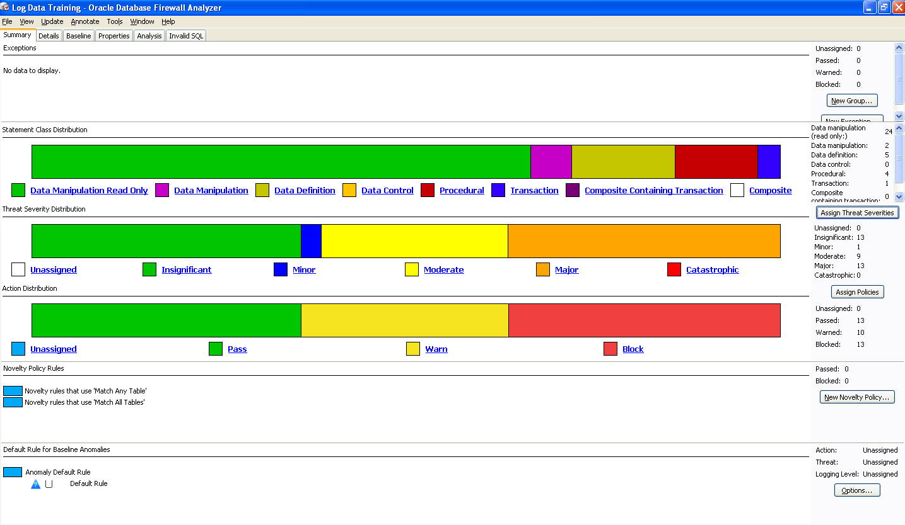
We can see here that the sql statements have been identified and assigned a level of threat
We can look at the sql statements and see where the understanding of threat and risk
Comes from

Slide 15
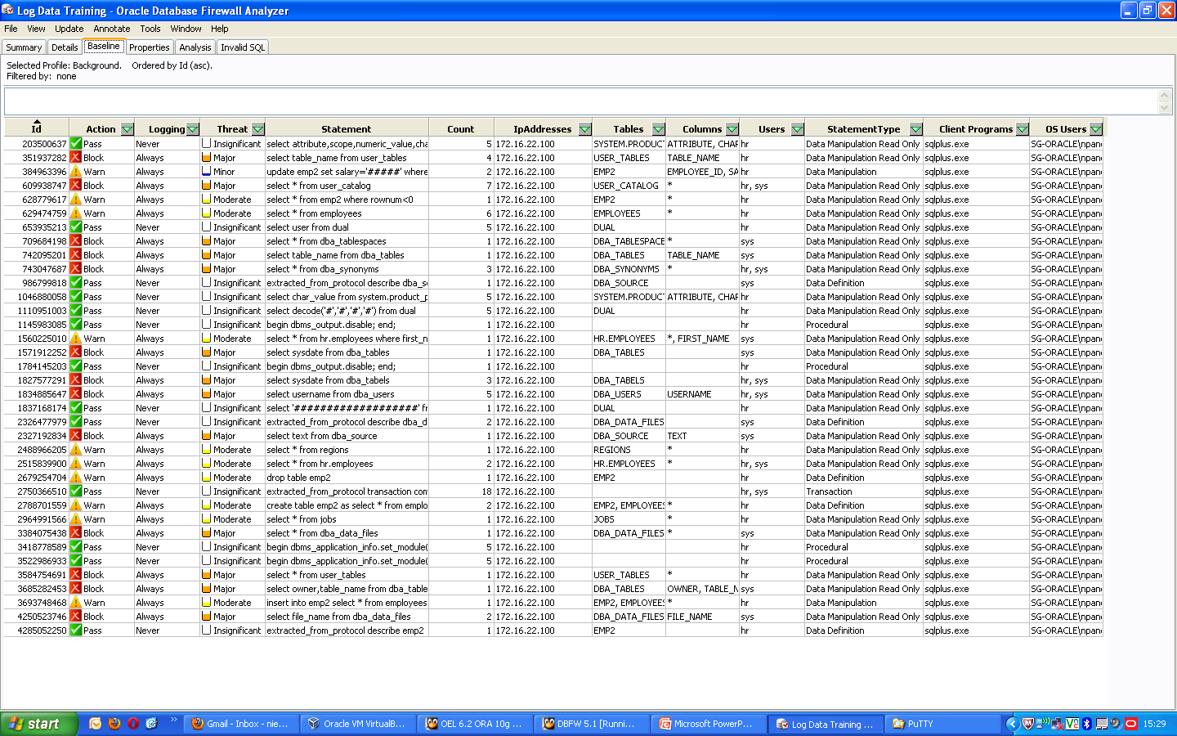
Under the baseline tab we can see all the sql’s captured in this MODEL – we can see
How DBFW has assigned a level of risk to each statement based on its own understanding of
Risk.

Slide 16
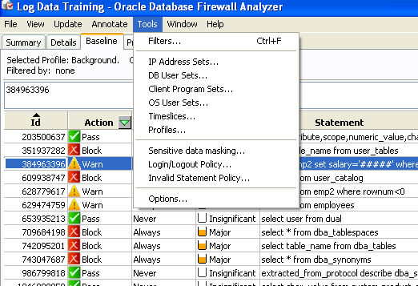
Sets and Channels
Under the tools tab you can see a drop down menu which allows you to control sql statements based on users, ip addresses, OS users, client programs etc – these can be combined to form a channel

Slide 17
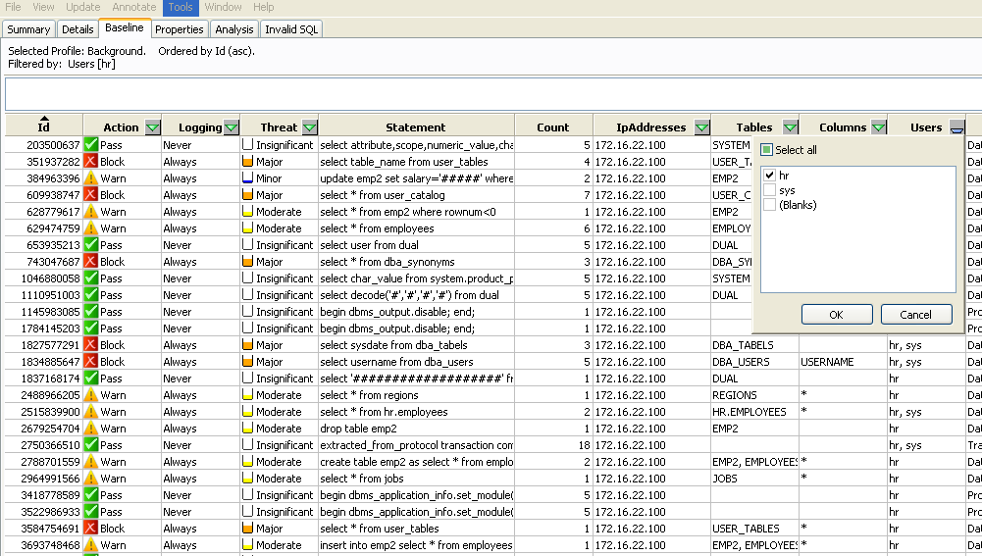
Grouping SQL Statements
Lets say we want to protect all HR tables.
We can use the filter on USERS column to look at the statements run by HR
We can now create a policy based on this. Say for example we want to protect the employees table and have a warning every time a select against this table is executed.

Slide 18
Protecting the HR Employees table
Connect through your sql plus (start >all programs>Oracle Client 10g Express Edition>Run SQL Command Line
Use the following connection string at the prompt :-
conn hr/seeingred@172.16.22.150:15211
This is because we are connecting via a proxy on the DB FW (172.16.22.150) and a proxy port is set up on 15211

Slide 19
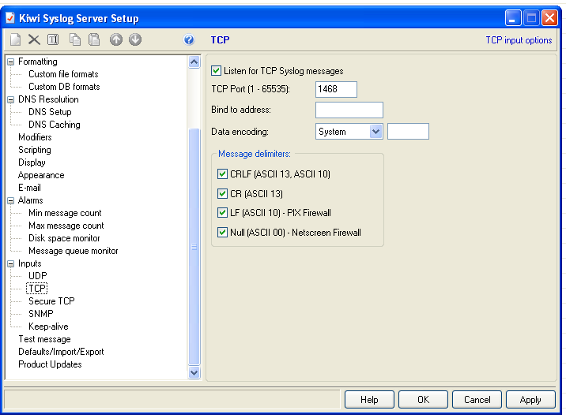
Demo syslog output
Once you startup up Kiwi syslog Server you need to go to File>Setup
and make sure the TCP setting is as above - click apply
This tool is used to capture syslog messages and demonstrate
that DBFW messages immediately

Slide 20
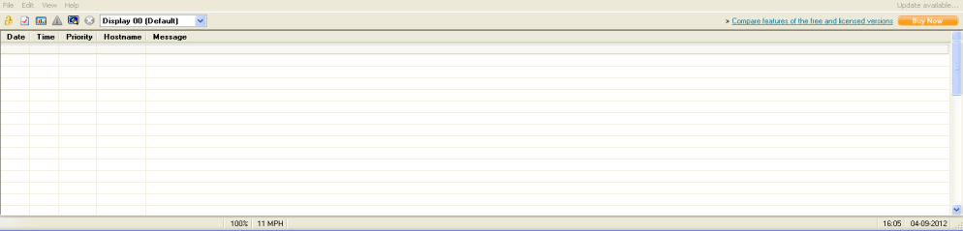
Make sure kiw syslog is running
This will give us the warning messages that will normally be sent to syslog – we are using kiwi syslog to view the messages

Slide 21
In the sql plus command window execute the following statement
select * from employees
You will see no warnings in syslog – we don’t have a policy for this yet. Lets go and set a policy.

Slide 22
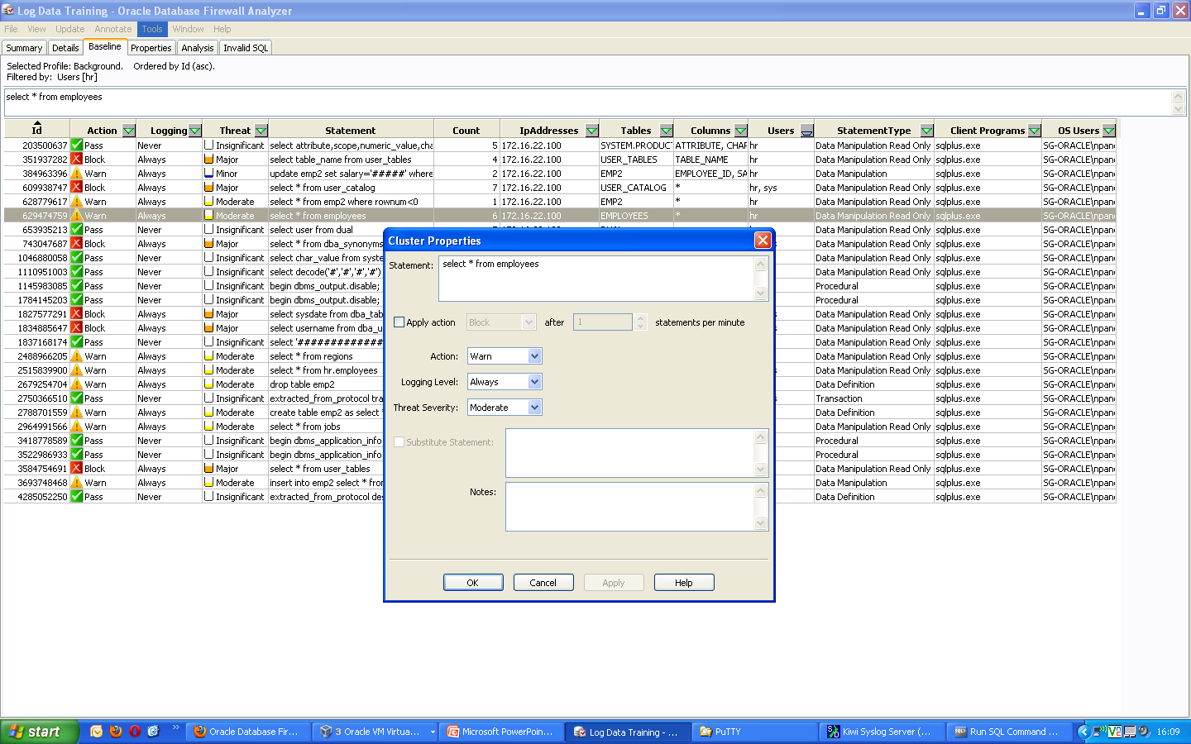
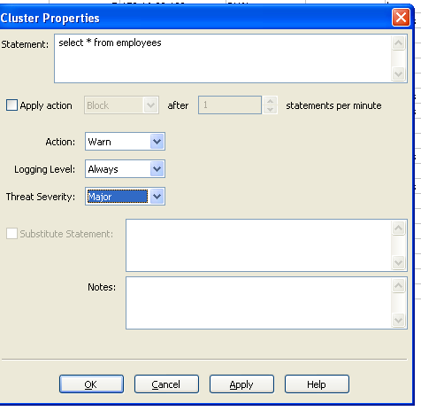
In DBFW Analyzer click on the statement “Select * from Employees” and click on properties. Here we can set a policy for this statement.
We want to set the new policy to warn + always and threat severity should be major – click on apply and ok

Slide 23
Creating and uploading a policy
Once we have set our threat level for our new policy we can now create the policy and load it up to DB FW.
FILE>CREAT POLICY>name the policy and save it the the desktop (eg HR1.dna)
Go to the DBFW web portal under monitoring >policies>upload > click on browse and upload the policy just created
Now we need to activate this policy with our Enforcement point
In the current monitoring Tab >enforcement points>list >click on settings >select the HR1.dna policy and click save

Slide 24
In the Kiwi Syslog server clear any old messages with “CTRL L “
In your sql plus command window type disc – this disconnects the session
Now reconnect with
conn hr/seeingred@172.16.22.150:15211
And type select * from employees;
You should see output generated to syslog

Slide 25
Updated reports for forensics
Now that you have run this statement and created a warning – we should also have information on this in a report.
In your DBFW web portal go to reporting >log search results >click on update
Once the results are returned as “completed” click on “all traffic for Peoplesoft”
If we go to the very last page we will see our warnings generated for our statement

Slide 26
What we have demonstrated
How DBFW can be used as a proxy
How DB FW analyzer collects statements for Modelling data and creating policy
How sensitive data that is collected and masked in our logs
How quickly we can set up policy and protect databases
How the forensic information is collected.

